Slide 1
The New Testament IS A PATTERN
For the Worship of the Church
Part 7

Slide 2
Previously:
Lesson 1:
  God has always held men to a pattern to follow
  A pattern existed in the OT time for people to obey
Lesson 2:
  Six reasons why a pattern exists today
Lesson 3:
  Five things that must be true if a pattern exists
Lesson 4:
  Holding fast the pattern
Lessons 5a, 5b:
  Enemies and friends of the pattern
Lesson 6:
  Seven truths to successfully follow the pattern

Slide 3
To Successfully Follow THE PATTERN:
It must currently exist
It must be complete
It must be deliberately revealed
It must be understandable
It must be intended for others to observe
It must be adopted and obeyed
It can only be met with an approved agreement when fully replicated

Slide 4
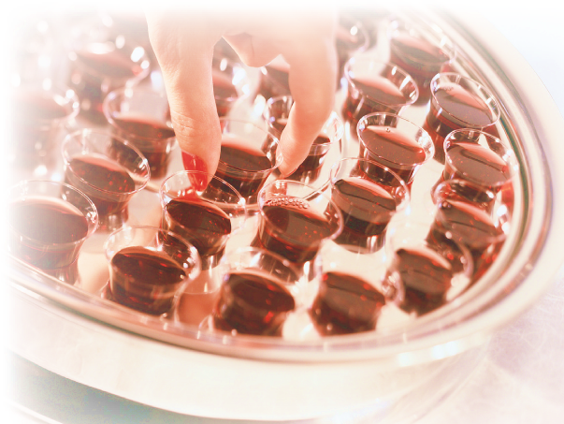
Since The New Testament Is Our Pattern
There is a pattern for:
The worship of the church (Jn. 4:23, 24)
  Observing the Lord’s Supper (Acts 2:42; 20:7)
    Memorial
    Unleavened bread
    Fruit of the vine
    Taken in kingdom
    In the local assembly
    On the first day of the
    week

Slide 5
How Churches Violate The Pattern
Catholics
  Many members partake of only the bread while the priests partakes of both the bread and cup
Various Denominations
  Offer the Lord’s Supper at all different times (Saturday, quarterly, annually)
  Jehovah’s Witnesses seek to offer it on the actual Passover date which violates Acts 2:42; 20:6, 7
  change the elements (leavened bread, alcoholic wine, water)

Slide 6
Mormons
Use water and bread
“For, behold, I say unto you, that it mattereth not what ye shall eat or what ye shall drink when ye partake of the sacrament, if it so be that ye do it with an eye single to my glory—remembering unto the Father my body which was laid down for you, and my blood which was shed for the remission of your sins” (Doctrines and Covenants 27:2)
“Water is now used instead of wine in the sacramental services of the Church” (www.lds.org/scriptures/dc-testament/dc/27?lang=eng)

Slide 7
Jesus Versus Mormon’s Moroni
Mormons: “…it mattereth not what ye shall eat or what ye shall drink when ye partake of the sacrament…” (DC 27:2)
Jesus “Then He took the cup, and gave thanks, and gave it to them, saying, ‘Drink from it, all of you. For this is My blood of the new covenant, which is shed for many for the remission of sins. But I say to you, I will not drink of this fruit of the vine from now on until that day when I drink it new with you in My Father’s kingdom’” (Matt. 26:27-29)

Slide 8
Paul Versus Mormon’s Moroni
Mormons: “…it mattereth not what ye shall eat or what ye shall drink when ye partake of the sacrament…” (DC 27:2)
Paul:
  “For as often as you eat this bread and drink this cup, you proclaim the Lord’s death till He comes” (1 Cor. 11:26)
  No authority for any other kind than “this bread” and “this cup” to proclaim the Lord’s death

Slide 9
Paul Versus Mormon’s Moroni
Mormons: “…it mattereth not what ye shall eat or what ye shall drink when ye partake of the sacrament…” (DC 27:2)
Paul:
  “For he who eats and drinks in an unworthy manner eats and drinks judgment to himself, not discerning the Lord’s body” (1 Cor. 11:29)
  The manner in which the Supper is taken does matter!

Slide 10
Paul Versus Mormon’s Moroni
Mormons: “…it mattereth not what ye shall eat or what ye shall drink when ye partake of the sacrament…” (DC 27:2)
Paul:
  “And whatever you do in word or deed, do all in the name of the Lord Jesus, giving thanks to God the Father through Him” (Col. 3:17)

Slide 11
Paul Versus Mormon’s Moroni
Mormons: “…it mattereth not what ye shall eat or what ye shall drink when ye partake of the sacrament…” (DC 27:2)
Paul:
  “But even if we, or an angel from heaven, preach any other gospel to you than what we have preached to you, let him be accursed” (Gal. 1:8)

Slide 12
Since The New Testament Is Our Pattern
There is a pattern for:
The worship of the church (Jn. 4:23, 24)
  Observing the Lord’s Supper (Acts 2:42; 20:7)
  Singing songs (Mk. 14:26; Eph. 5:19; etc.)
    A cappella
    Spiritual and truthful
    Within and without the congregation
    To God as well as admonishing/teaching one another

Slide 13
Since The New Testament Is Our Pattern
There is a pattern for:
The worship of the church (Jn. 4:23, 24)
  Observing the Lord’s Supper (Acts 2:42; 20:)
  Singing songs (Mk. 14:26; Eph. 5:19; etc.)
  Freewill giving on the first day (1 Cor. 16:1, 2)
  Prayer (Acts 2:42; 1:14; 6:4; 12:5; 14:23; 16:13, 16, 25; etc.)
  Preaching/teaching (Acts 2:42; 20:7; 1 Pet. 4:11)

Slide 14
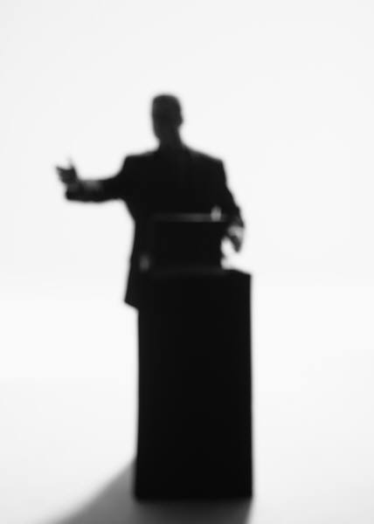
Preaching After The Pattern
The word (2 Tim. 4:2)
Speaking as the oracles of God (1 Pet. 4:11)
Public and house studies (Acts 20:20)
Preaching Christ (Acts 8:5)
Preaching the kingdom (Acts 20:25)
Preaching The whole counsel of God (Acts 20:26, 27)
Expounding the scriptures (Lk. 24:27, 32; Neh. 8:8)

Slide 15
It Is YOUR Responsibility to Be A Member Of A CHURCH WHICH HONORS CHRIST’S PATTERN

Slide 16
Matthew 15:13, 14
¹³ But He answered and said, "Every plant which My heavenly Father has not planted will be uprooted.
¹⁴ "Let them alone. They are blind leaders of the blind. And if the blind leads the blind, both will fall into a ditch."

Slide 17
2 Timothy 1:13
¹³ Hold fast the pattern of sound words which you have
heard from me, in
faith and love
which are in
Christ Jesus.
IN CHRIST
Paul’s Preaching
Pattern of
Sound Words

